Slide 1
Understanding Sorting Algorithms: Bubble Sort, Selection Sort, and Insertion Sort
A Look into Sorting Algorithms in Python

Slide 2


Introduction to Sorting Algorithms
Sorting algorithms arrange data in a particular order (ascending or descending).
Importance:
Helps in data organization
Essential in searching algorithms
Optimizes performance in applications like databases and machine learning
Real life examples of
sorted data

Slide 3
Introduction to Sorting Algorithms
Sorting algorithms arrange data in a particular order (ascending or descending).
Importance:
Helps in data organization
Essential in searching algorithms
Optimizes performance in applications like databases and machine learning

Slide 4
A dictionary is sorted in alphabetical order.
If all the words were randomly placed in the dictionary, it would be useless.

Slide 5
A Phone book is sorted in numerical order.
This is for the ease of the user when searching for a particular phone number.

Slide 6
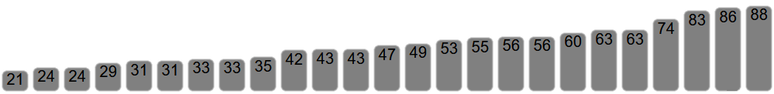
Types of Sorting Algorithms
Bubble Sort: Simple but inefficient for large datasets.
Selection Sort: Good for small datasets, easy to understand.
Insertion Sort: Efficient for partially sorted data or small datasets.

Slide 7
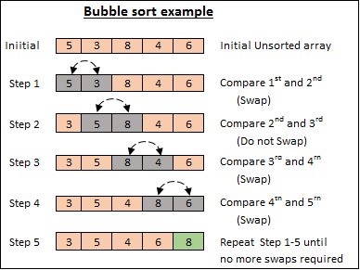
Bubble Sort
Repeatedly compares and swaps adjacent elements if they are in the wrong order.
Steps:
Start at the beginning of the list.
Compare each pair of adjacent elements.
Swap if the first element is greater than the second.
Repeat the process for every element in the list.

Slide 8
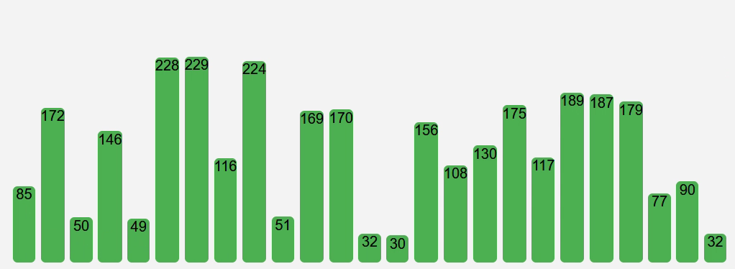
Bubble sort in action

Slide 9
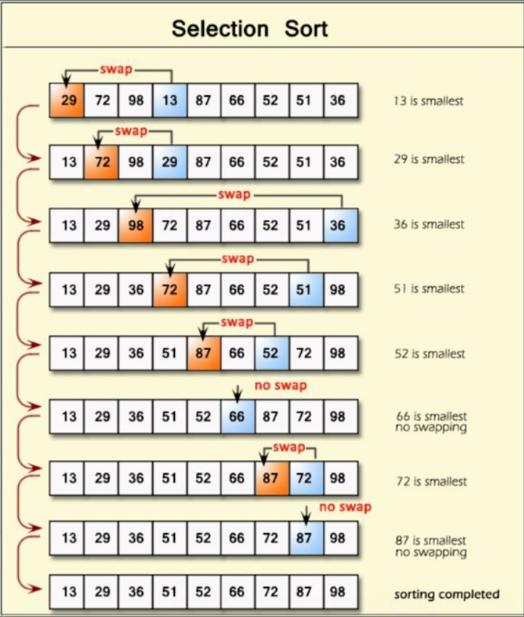
Selection Sort
Finds the minimum element from the unsorted part and swaps it with the first unsorted element.
Steps:
Start with the first element.
Find the smallest element in the unsorted part.
Swap it with the first element.
Repeat the process for the rest of the list.

Slide 10
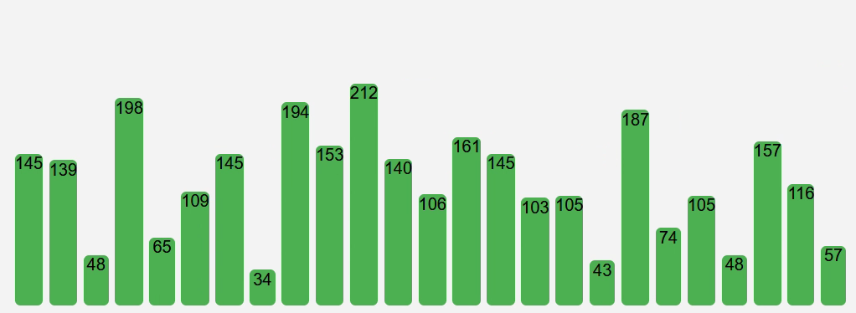
Selection sort in action

Slide 11
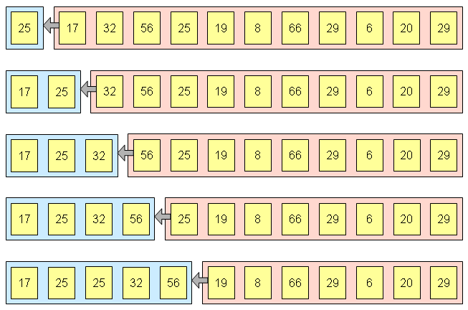
Insertion Sort
Builds the sorted array one element at a time by inserting elements into their correct position.
Steps:
Take the next unsorted element.
Move it backward until it's in the correct position relative to the sorted portion.
Repeat until the list is sorted.

Slide 12
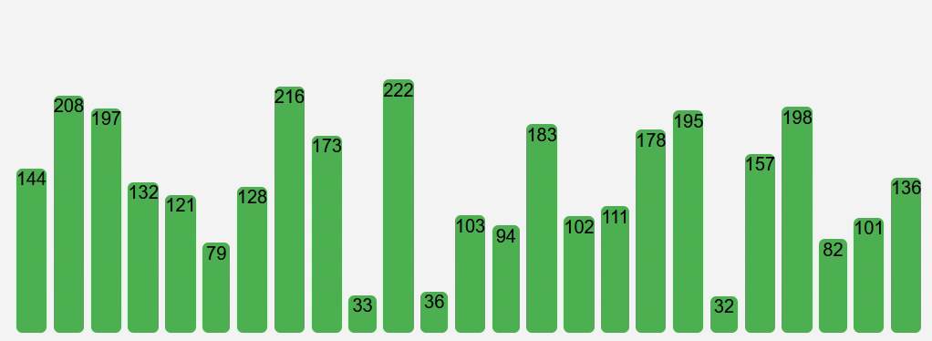
Insertion sort in action

Slide 13
Music used in the video
Royalty Free Music: https://www.bensound.com
License code: 4QVIKXA2XNTNT7DL

